Slide 1
Community
Quick Start Guide

Slide 2
Community Quick Start Guide | Contents
Community Purpose | 1
Discussion Posts & Replies | 9
How to find the community | 2
Discussion Tagging | 10
Community Homepage | 3
Community Directory | 11
Community Profile | 4
Anonymous Posting & Moderation | 12
Privacy & Notification Settings | 5
Ribbons Summary | 13
Friend Connections & My Inbox | 6
Community Subscriptions | 7
Community Homepages | 8

Slide 3
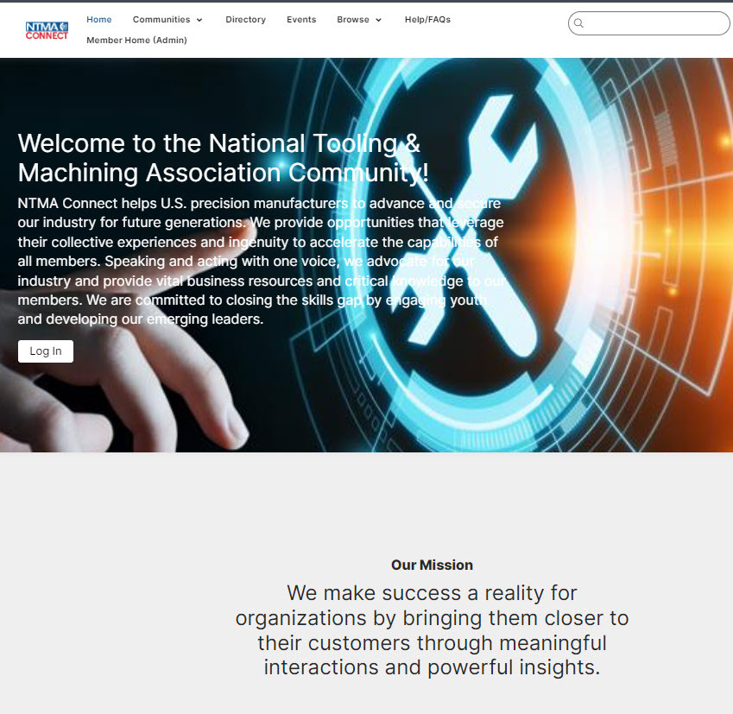
1
Community Purpose
Network in a secure, professional, dedicated social network just for members.
Connect with a wide variety of peers from diverse sectors, professional backgrounds and career stages.
Join the discussion space to ask fellow members your professional questions, share challenges and support others with ideas.
View important updates and resources from our team.
Navigate Back to Contents Page

Slide 4
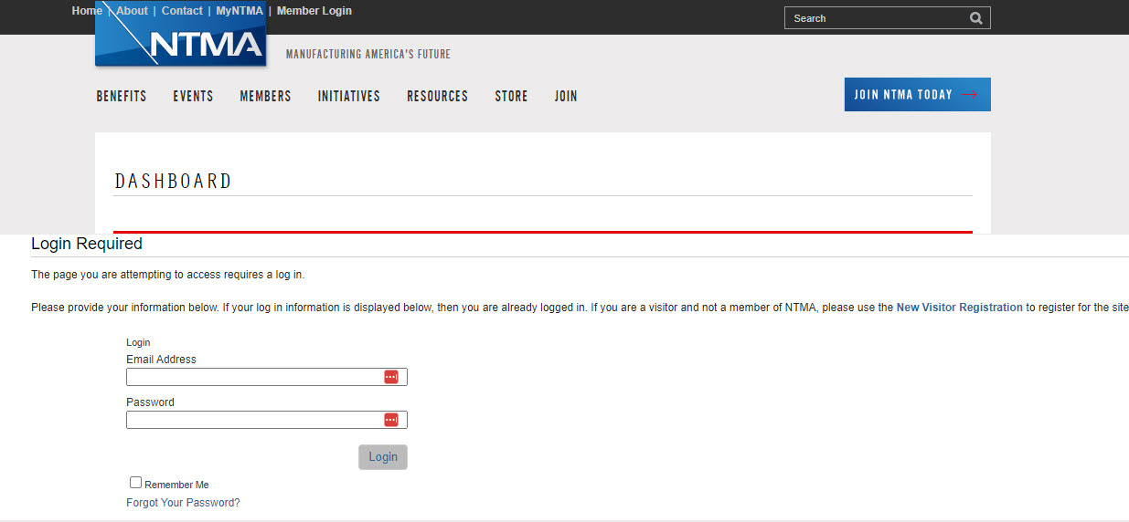
2
How To Find The Community
Login via this URL: https://members.ntma.org/eweb/DynamicPage.aspx?WebCode=LoginRequired&expires=yes&Site=NTMA2011
Navigate Back to Contents Page

Slide 5
3
Community Homepage
Your community homepage is a snapshot of the community platform which is tailored to you.
You'll be able to engage with
a central feed of community discussions you are subscribed to
your profile and community activity
discussions and other content you have chosen to follow or posted yourself
quick links helpful to all community members
community polls
blog posts
events of interest.
Members will also be able to navigate to a Member Directory of all community members from the navigation bar.
Navigate Back to Contents Page

Slide 6
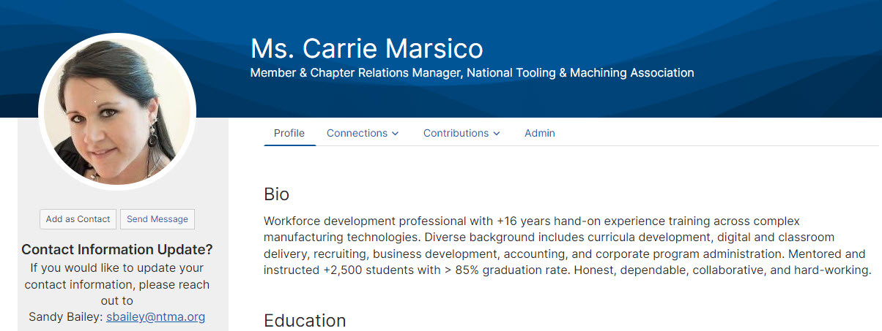
4
Community Profile
Your community profile is the place to showcase your professional identity and interests.
The community profile page is a valuable way for other members to learn about you, as well as a way for you to track your posts and file uploads, and set your community subscription and privacy settings.
Navigate to your profile by clicking on the circle icon (with your initials inside) next to the search bar on the top right.
Upload a profile picture by clicking the 'Change Picture' button under 'Actions'.
Add a summary of your professional experience and interests in the About Me section, as well as any professional association, jobs and awards you might want to share.
You can also add social links, such as LinkedIn, under your profile picture.
Navigate Back to Contents Page

Slide 7
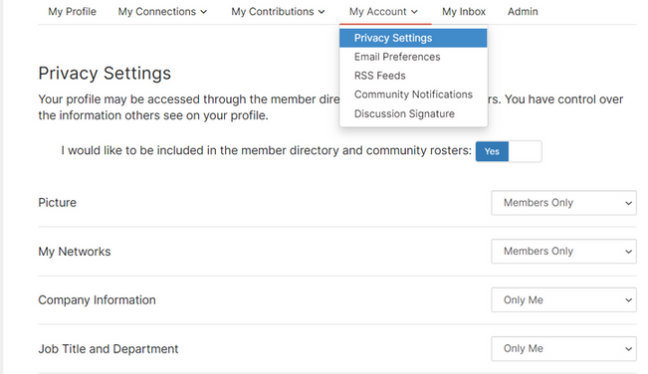
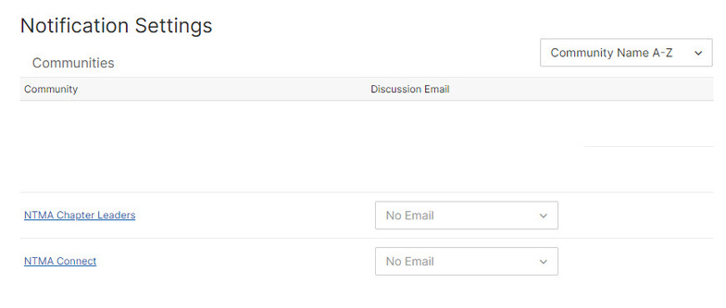
5
Privacy & Notification Settings
Your community profile is also the go-to place to update your settings.
Privacy Settings
You can control who sees what about you in the community by updating your settings under My Account. You can choose from 4 settings for an extensive range of personal information:
Public
Members Only
My Contacts (members you have connected with as a friend in the community)
Only Me (which means while you may see your information in the community, no one else can)
Community Notifications (Email Digests)
You can also update your notification settings to ensure you are up to date on what's happening in the community. We recommend updating your settings when you first login. You can choose from:
No Emails
Real Time (messages are sent to you as they are posted)
Daily Digest (you can choose individual daily digests for all communities you're subscribed to, or one Consolidated Daily Digest with all the community updates in one email)
Weekly Consolidated Digest (tick the boxes for all the communities you want in the wrap up)
Navigate Back to Contents Page

Slide 8
6
Friend Connections & My Inbox
Your community profile will enable you to build a network full of connections and manage your own dedicated Inbox to communicate via direct message.
My Inbox
You will have access to a dedicated community Inbox accessible on your community profile and from a drop down menu when you click on your profile icon at the top of the page at all times.
The Inbox enables all members to reply privately to community posts, and direct message each other.
Friend (Contact) Requests and Community Invitations will also appear in My Inbox.
Navigate Back to Contents Page

Slide 9
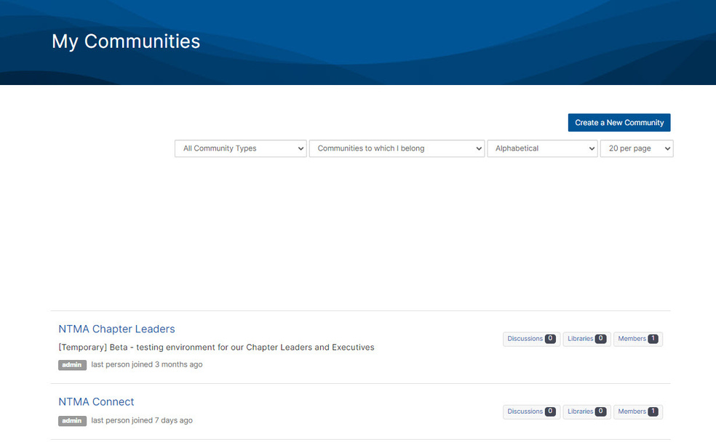
7
Community Subscriptions
All members are subscribed to the All Member Open Forum when they first login to the community. Members may also join or view other communities depending on their interests and volunteer status.
To find the communities to which you are subscribe:
View your My Communities list on the left side of the of the community homepage
Navigate to the Communities drop down in the navigation bar at the top of the page (this will be accessible no matter where you are in the site).
Find your personal list of community subscriptions on the 'My Connections' tab on your community profile.
You can join Communities of Interest by clicking on 'All Communities' from the navigation bar drop down, and selecting Request to Join OR Join (the red button on the right).
Some communities are View Only; you cannot set up community notifications for these communities, only the communities you are a member of.
Navigate Back to Contents Page

Slide 10
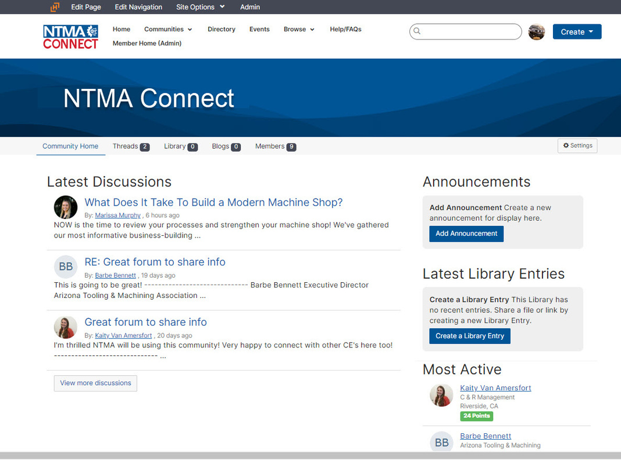
8
Community Specific Homepages
Once you've selected a community to view, you will see the Community Homepage for that community once you have selected it.
Each community space has the same basic layout, including:
A main homepage which shows
Most recent or featured posts displayed.
Most recently posted resources featured.
Announcements section, where important updates may be posted.
On the top tabs section, you will find
The Library, where members can upload resources, links and photos to share with each other.
Community Blogs, where longer updates may be posted.
Events, where community management and admins may post upcoming events of interest.
Member List, which displays all the members of the specific community you are viewing.
Navigate Back to Contents Page

Slide 11
9
Discussion Posts & Replies
Members can post in the community via multiple different methods.
Option 1: In the Community
Navigate to the Create drop down button at the top right of the community homepage to start a post.
You will be prompted to choose the community you would like to post in on the post editing page.
Go to a Community space via the My Communities list, and click the 'Add' button next to the Latest Discussions section on the Community Homepage.
You can Reply to a message directly on the post both publicly or privately.
Choose the 'Reply Directly' option from the drop down menu accessible next to the Reply button.
Want to save your post or schedule it? You can find your unposted messages by navigating to the 'Contributions > List of Contributions' tab on your community profile.
Option 2: Reply Via The Email Digest
If you are subscribed to the email digest, you can respond to a discussion thread, directly from the email.
Click the Reply via Email button located to the right side of your digest email. This will open a new email​.
Enter your contribution/reply and click send, as you would a normal email​
This will post your response to the discussion thread in the community
Please note: your email signature may post to the discussion unless you remove it from your message. Anonymous posting is not possible using this posting method.
Navigate Back to Contents Page

Slide 12
10
Discussion Tagging
Members can also tag each other and use hashtags to mark their posts with topics to optimise the Search function in the community.
Tagging Other Members
As you participate in various discussions with other members, you may come across a topic you are unfamiliar with but know an expert on the topic who might be able to help – this is a great opportunity to leverage this feature!
Members you @mention will receive an email that they've been mentioned with a quick link right to the post.
When posting a thread simply type @ or click the @ icon in the editing bar (as pictured) and then begin typing the name of whoever you'd like! The Community platform will provide a drop down list of potential members matching your query for you to select from. You then select the member and their name will appear like this @John Smith.
Tagging Your Posts and Library Entries
Tags help provide additional information or categorise content, and can provide a shortcut for searching so that members can discover other content tagged with the same tag. For example, click on a tag and you will be directed to search results filtered by that tag.
Members can apply/remove tags in their own content. If a member forgets to add a tag to their content, then Community Administrators can add tags retroactively too.
To apply/remove tags: start by typing "#" or click on the # icon when you are writing a post or adding a library entry. You will see a list of tags appear dropping down from your text. Select the tag you would like to use, or create one of your own related to your post by finishing your topic keyword (s).
Navigate Back to Contents Page

Slide 13
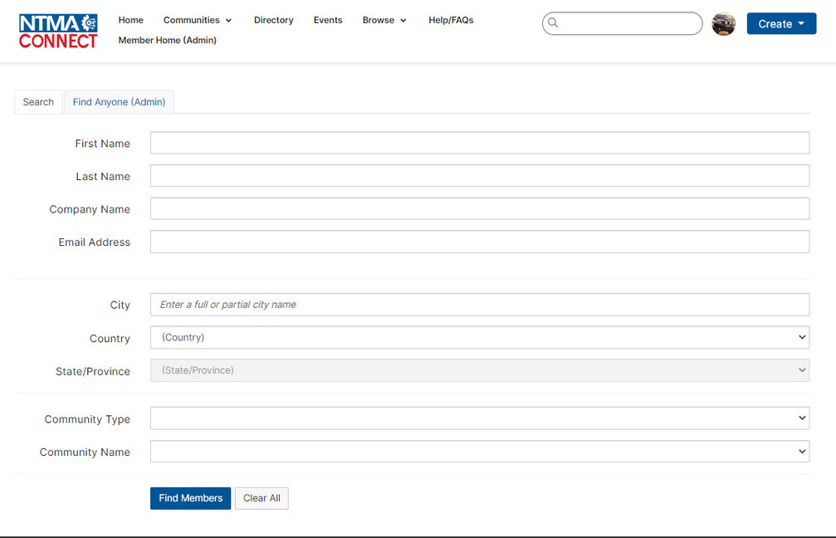
11
Community Directory
There is a community member directory accessible via the URL: https://client.intersystems.com/network/members
Members can search for peers via
Name
Company Name (if the member you are looking for has added this information to their profile)
Email address
City
Country
Note: if another member has elected to remove themselves from the directory, you will not be able to find them using this search area.
Navigate Back to Contents Page

Slide 14
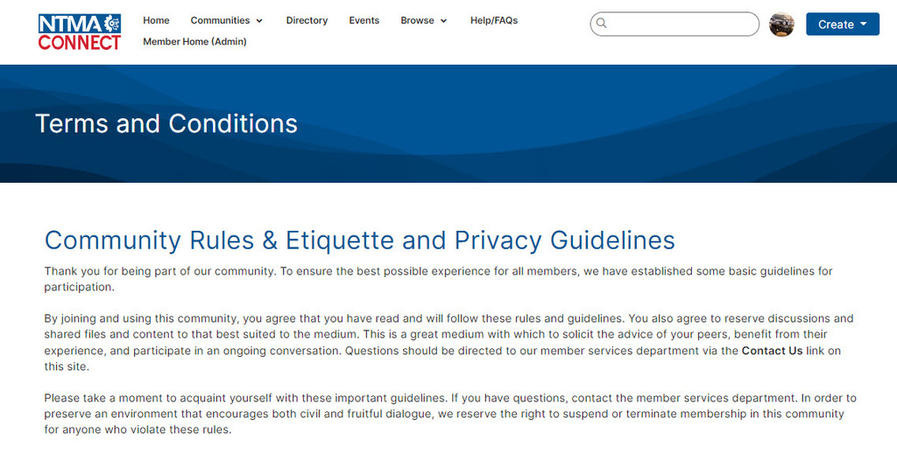
12
Moderation and Terms & Conditions
All members are encouraged to share in the community, keeping in mind the community Terms & Conditions (T&Cs) and being mindful to be supportive and productive whilst participating in discussions.
The community is regularly monitored by EA moderators and posts that conflict with the T&Cs will be proactively removed, edited in consultation with the post's author, or outright rejected if the post is not possible to amend to comply with the T&Cs.
If you feel that a post in the community requires moderation (temporary or permanent), you can flag the post by choosing the 'Mark As Inappropriate' option from the drop down menu next to the Reply button on a post.
If the post is deemed to not conflict with the T&Cs, the post may be re-approved or you may be contacted to discuss your reason for flagging further.
Navigate Back to Contents Page

Slide 15
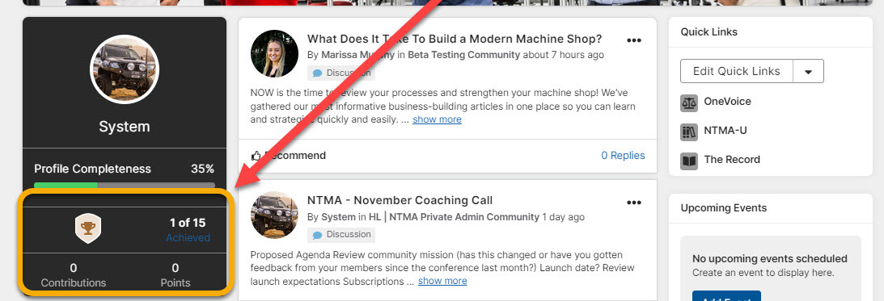
13
Ribbons
You may also see a ribbon pop up on your profile, or under your name whilst posting in the community. These ribbons are signifiers we allocate members based on volunteer positions, and leadership.
Navigate Back to Contents Page

Slide 16
Thank you for joining in the community.
If you ever need help in the community, feel free to reach out to our team:
insert community email address or Contact Us page here
admin@ntma.org
Navigate Back to Contents Page

